Slide 1
Indian Restaurants In Major U.S Tourist Cities
The Battle of Neighborhoods

Slide 2
What I Am Trying To Solve?
Select Place of Vacation in U.S based on Indian Restaurants.
Book Hotel room at perfect hotspot.
4 Cities to choose from:
Chicago
Miami
New York
Los Angeles

Slide 3
How I Am Trying To Solve?
Using FourSquare API through Venues channel to collect location data of chosen cities.
Using CategoryID “4bf58dd8d48988d10f941735” to show only Indian restaurants.
Foursquare limits us to maximum of 100 venues per query.
Using Folium to generate Maps with venue details for each of the Cities.

Slide 4
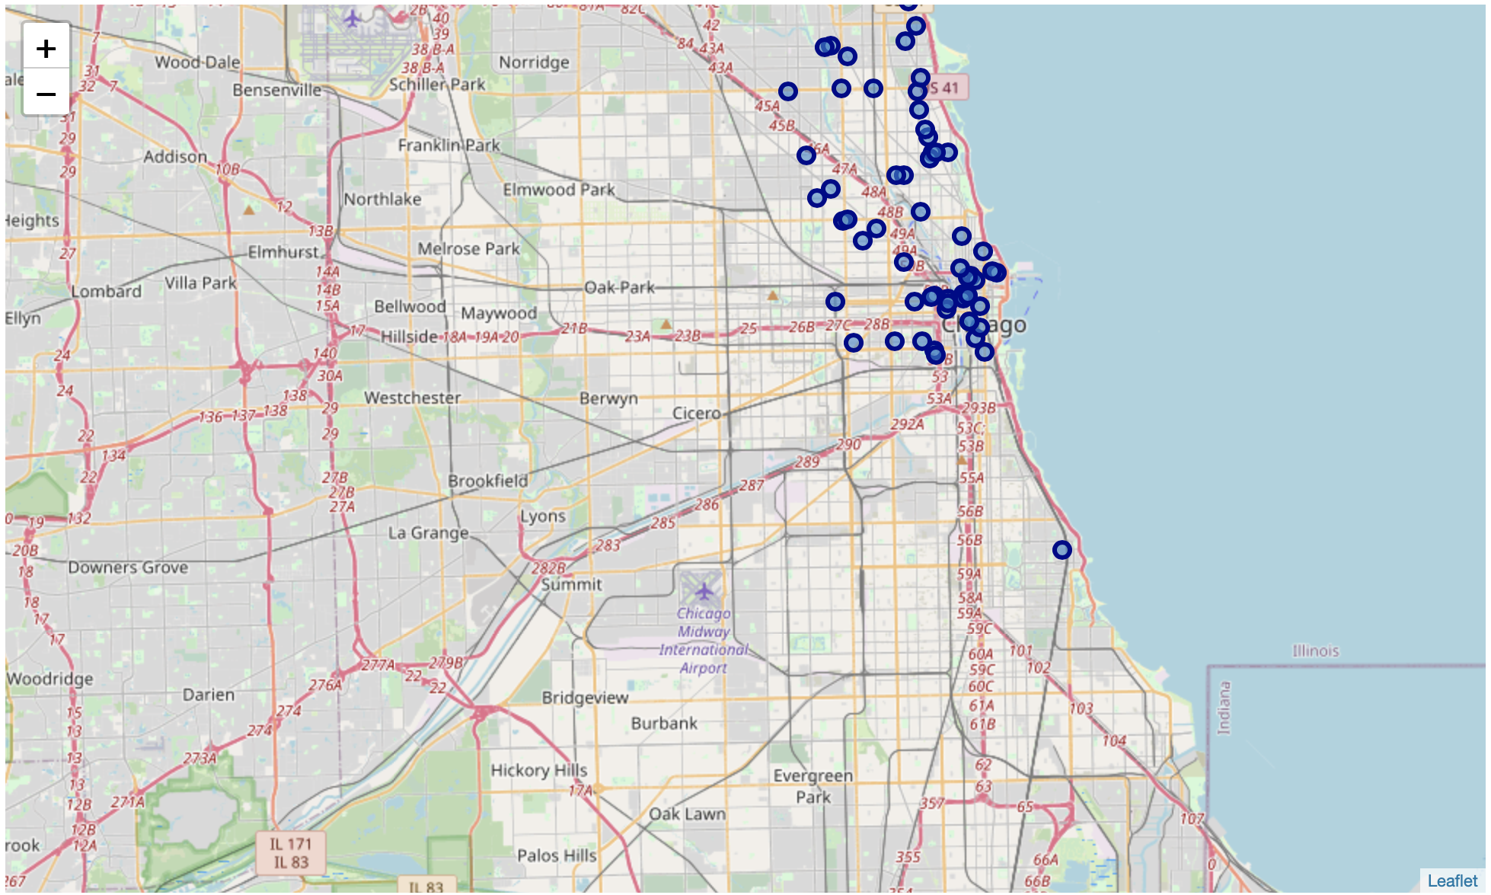
What Do I See?
Chicago Neighborhood Map:

Slide 5
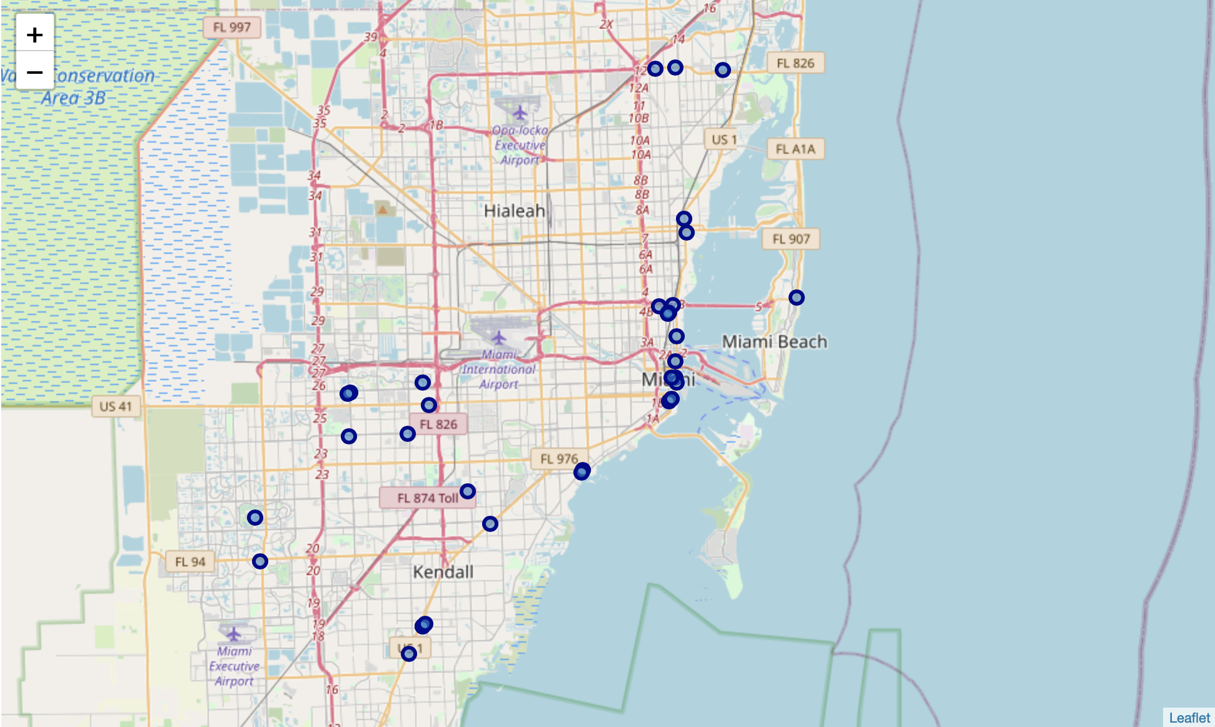
Miami Neighborhood Map:

Slide 6
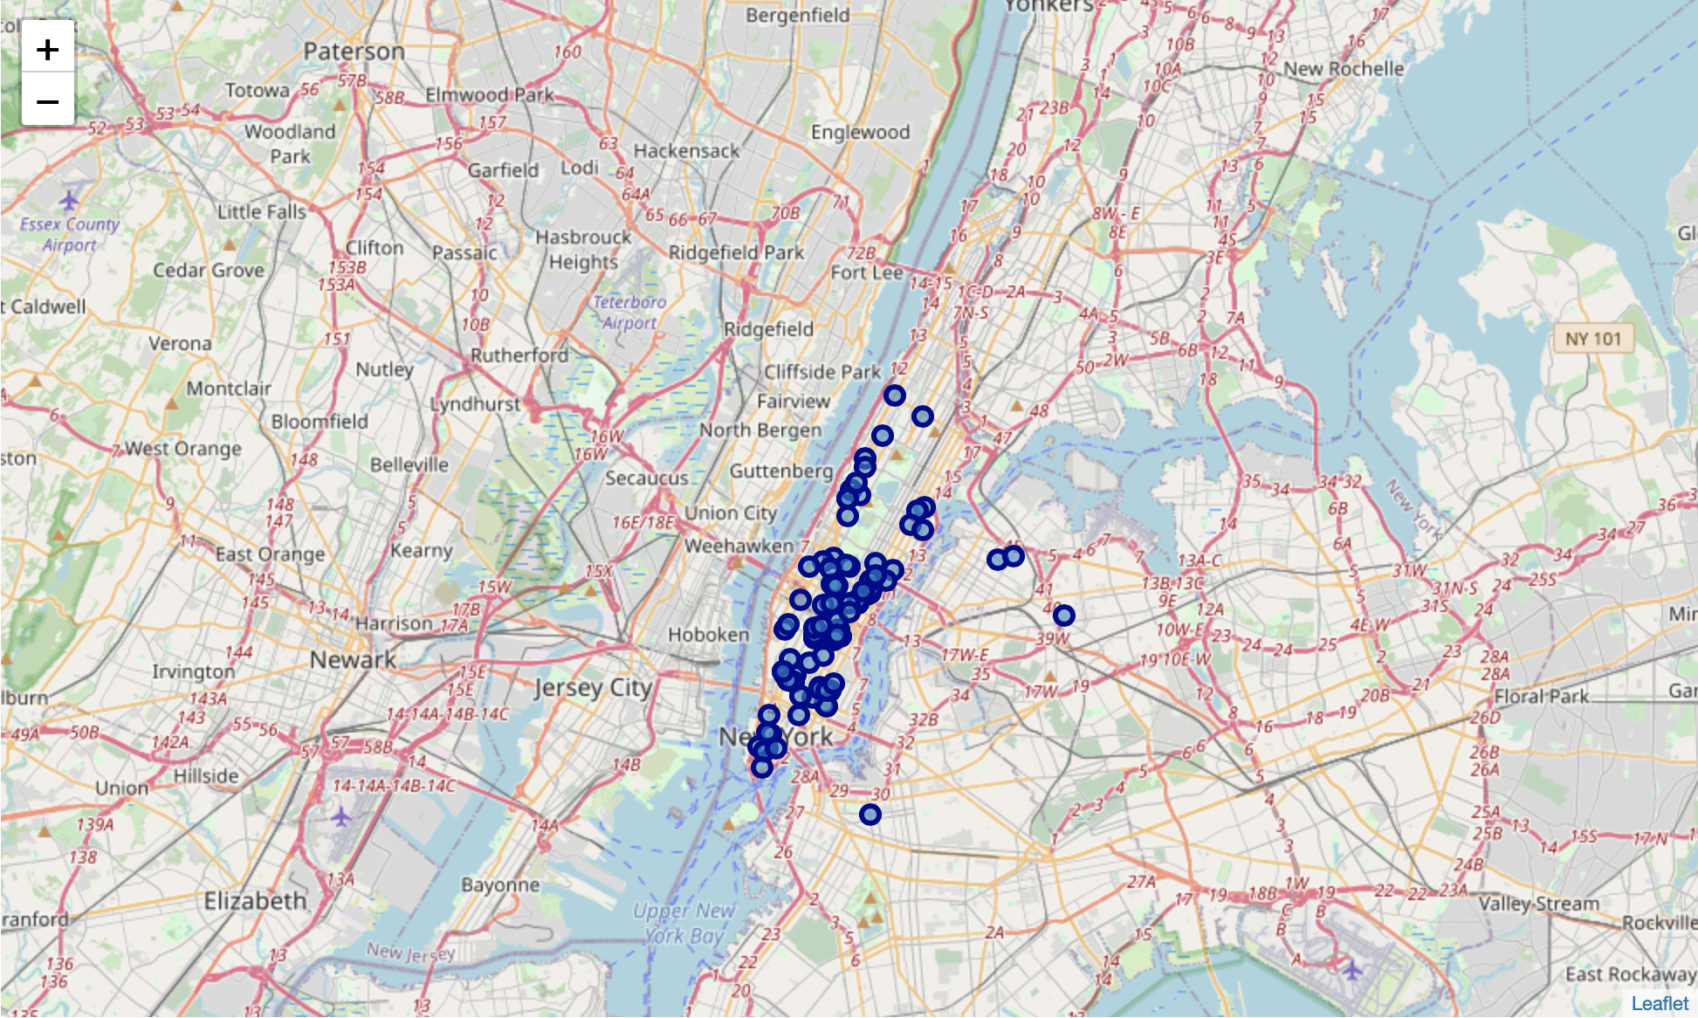
New York Neighborhood Map:

Slide 7
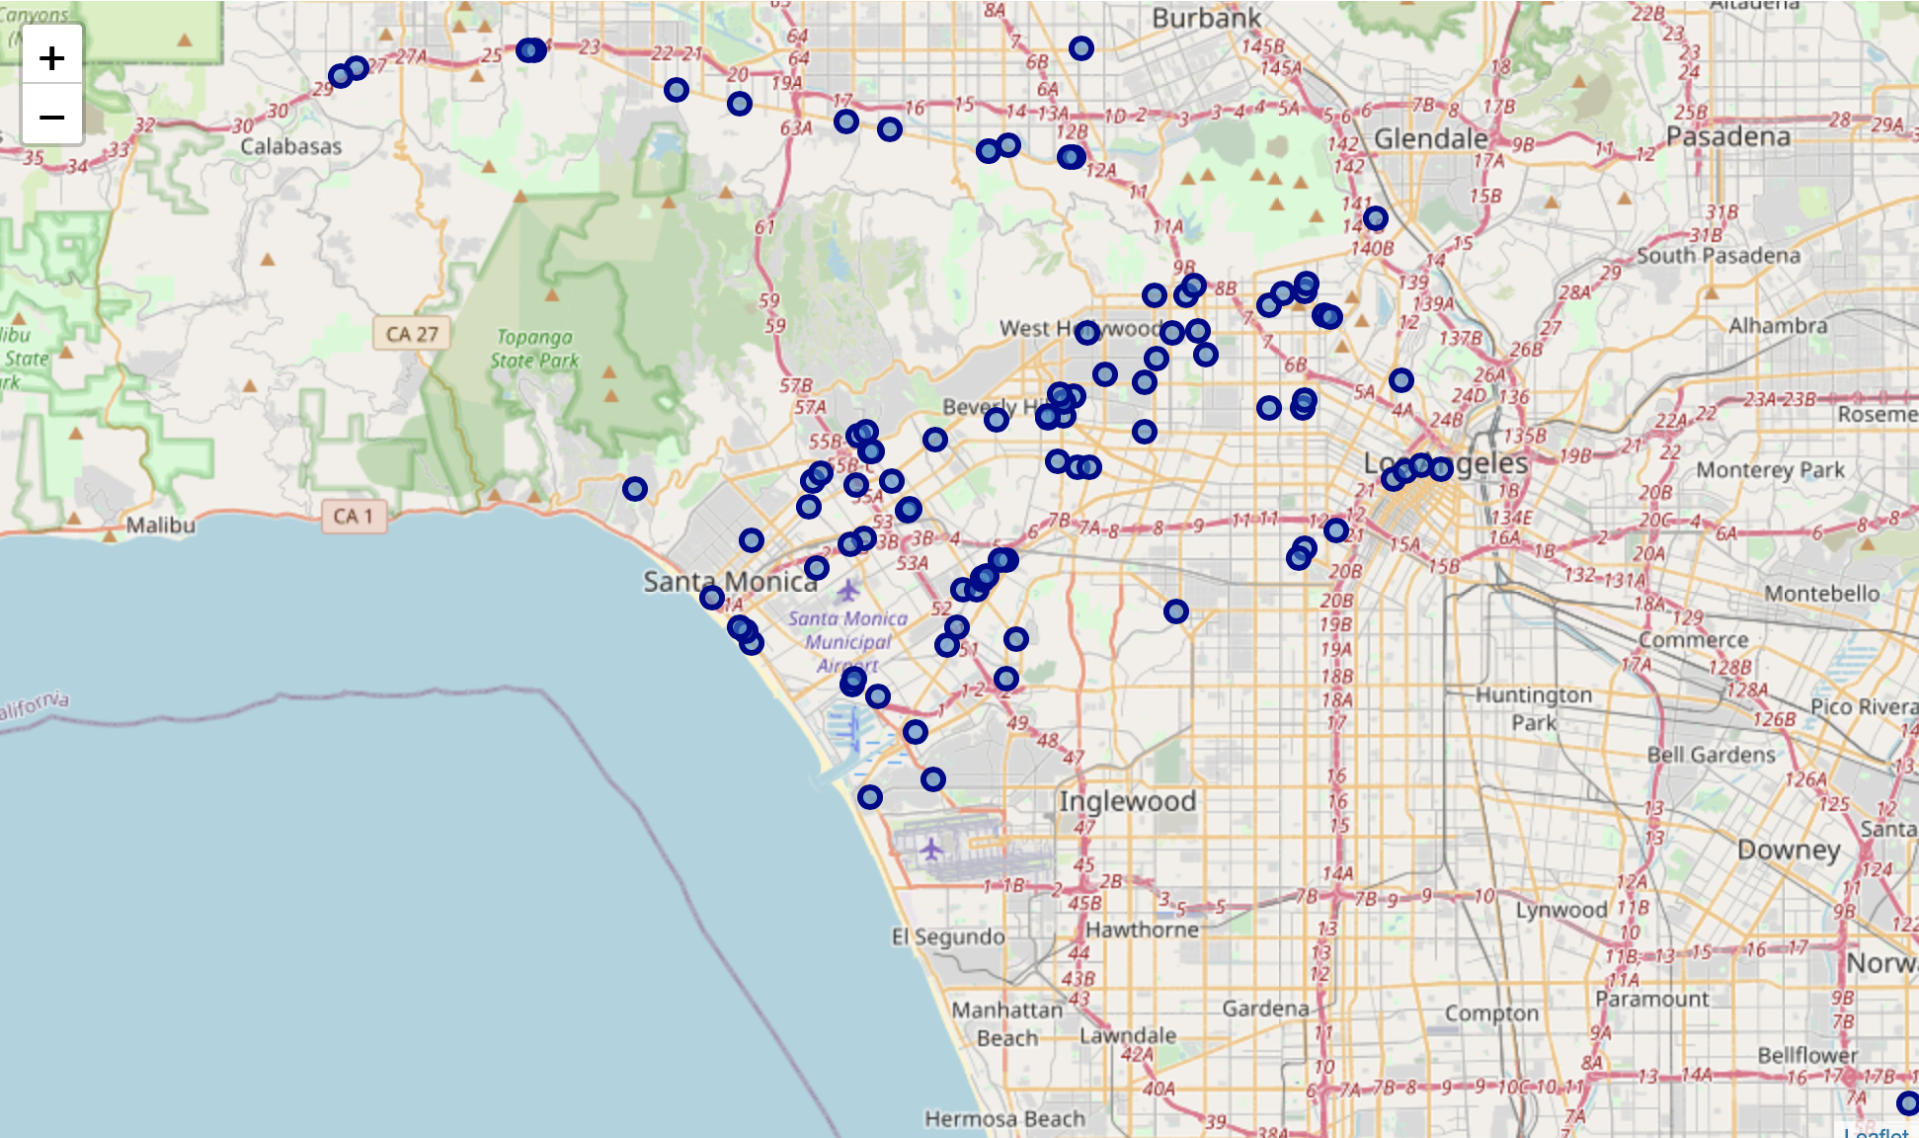
Los Angeles Neighborhood Map:

Slide 8
What Do I Get?
My Top 2 cities with a close 3rd.
New York
Los Angeles
Chicago
For more clarity, Let’s calculate the mean coordinate and the "Mean distance to Mean coordinate".

Slide 9
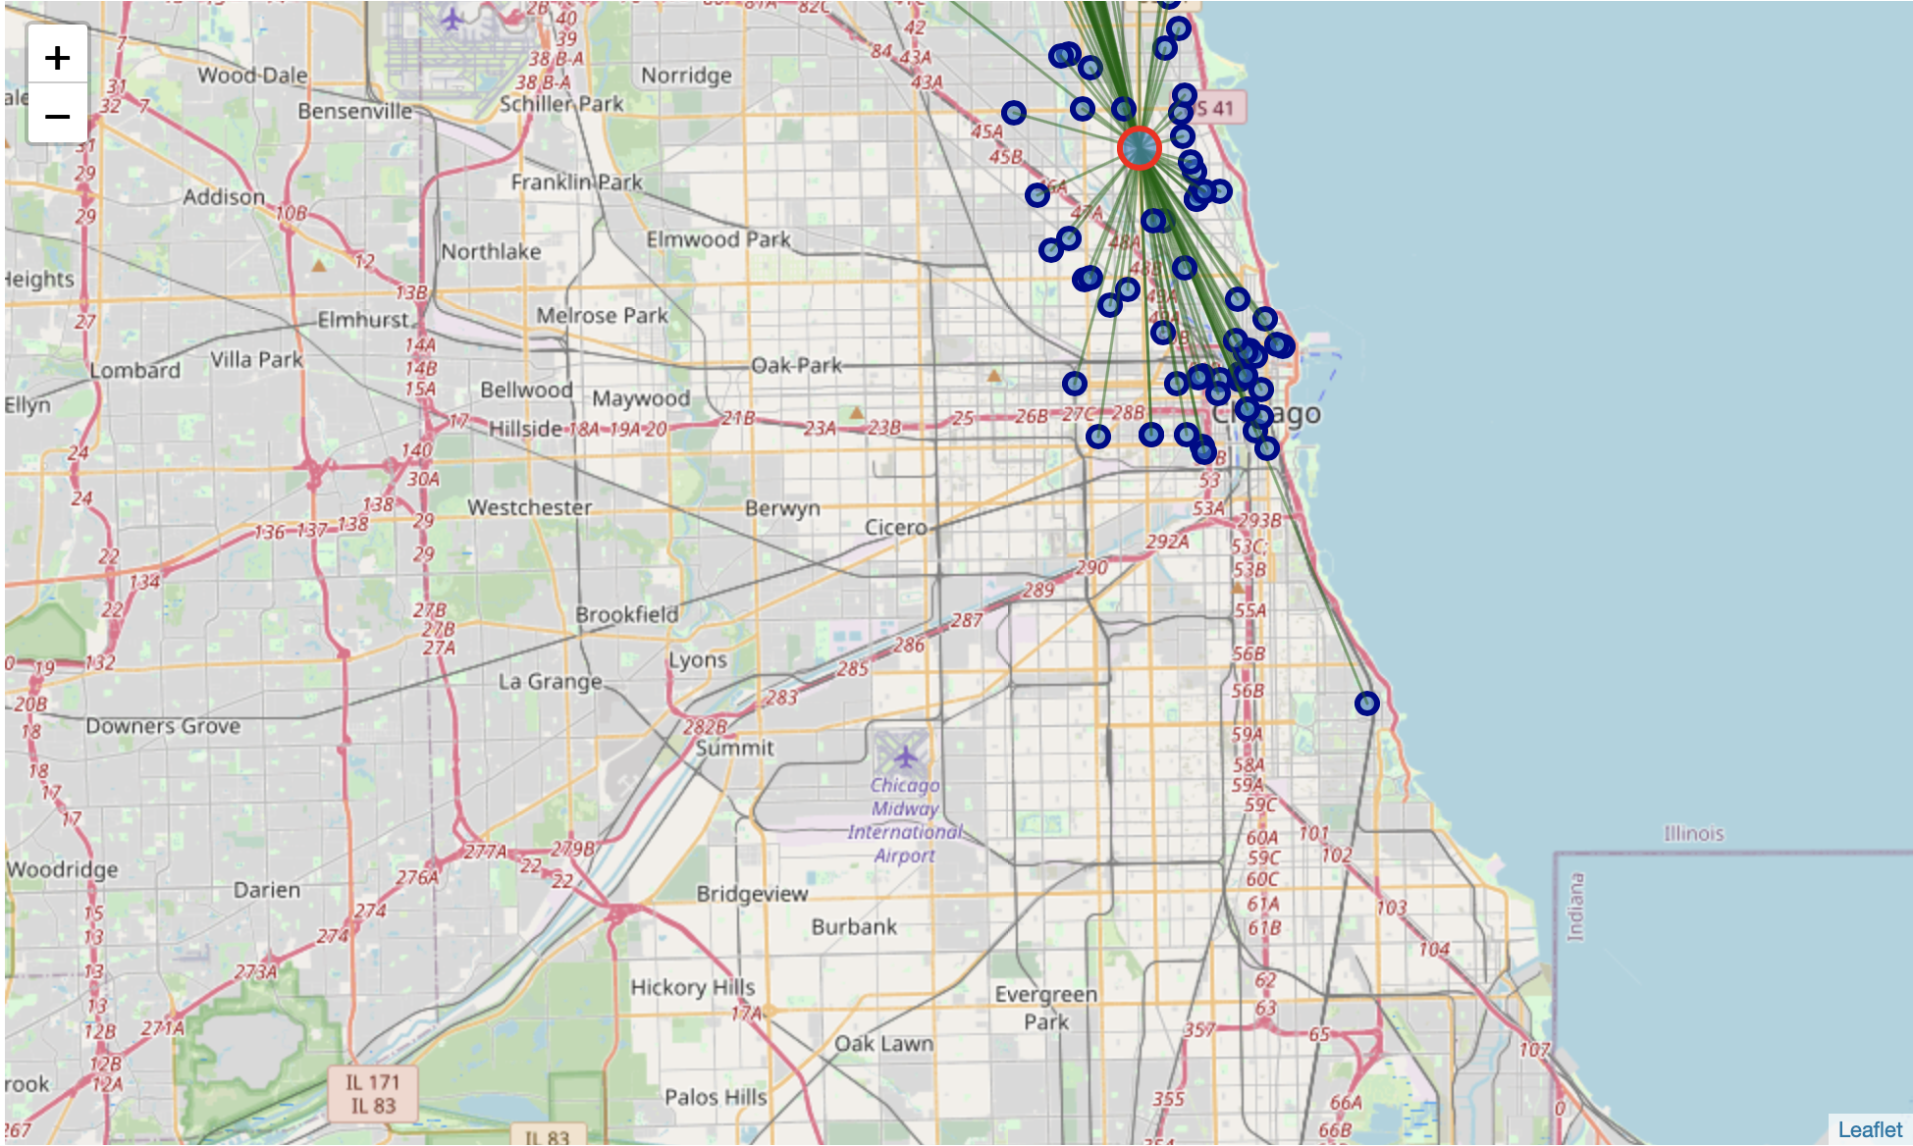
More Maps To Look At? But This Time With More Clarity…
Chicago:

Slide 10
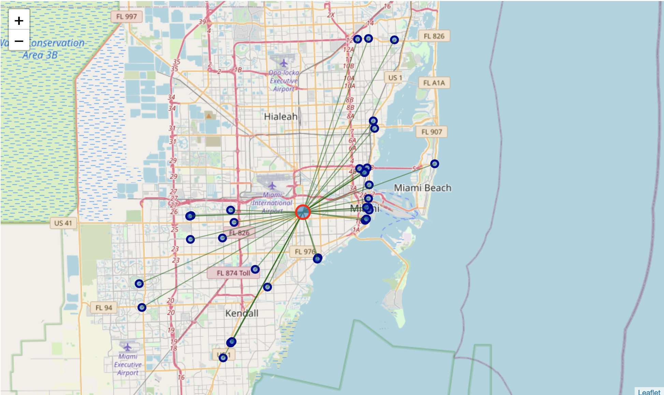
Miami:

Slide 11
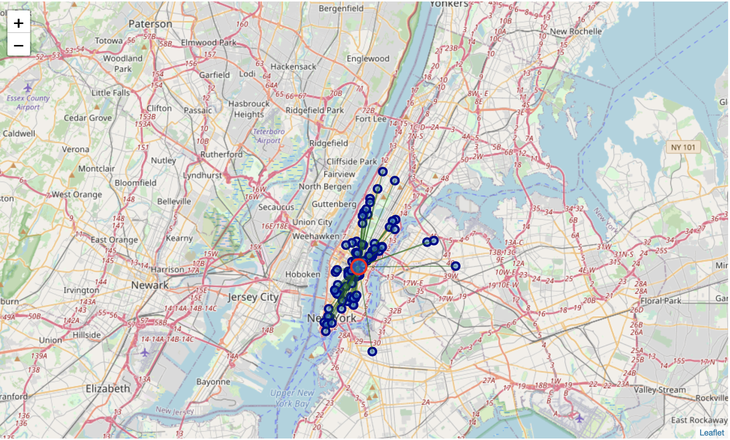
New York:

Slide 12
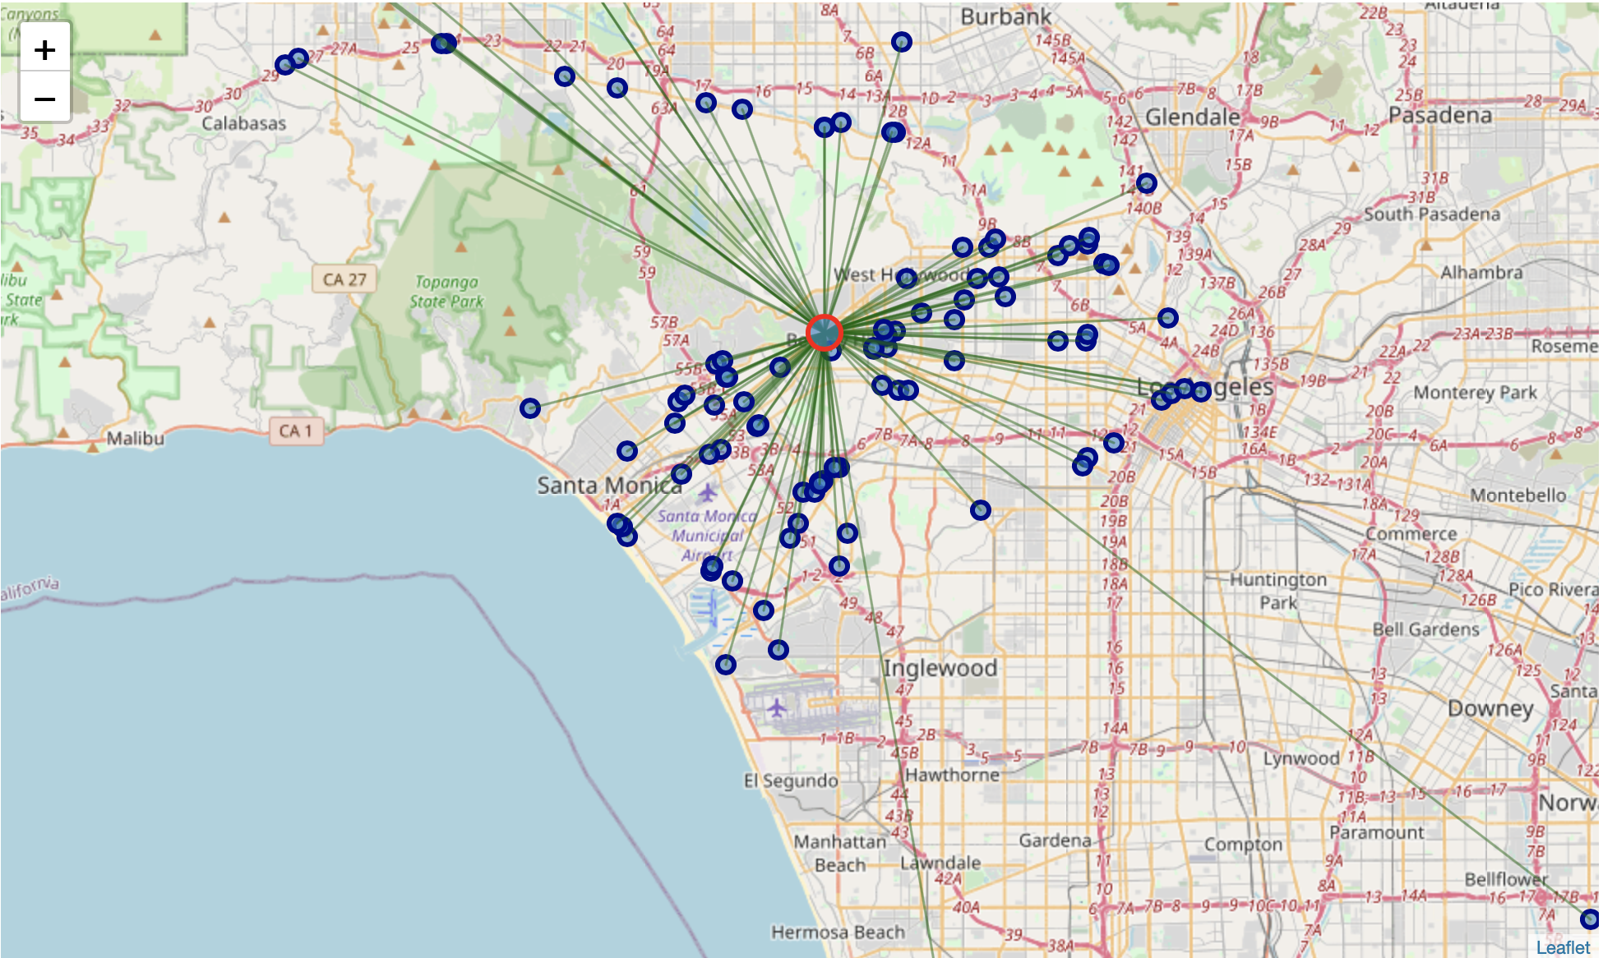
Los Angeles:

Slide 13
Any Conclusion Yet?
Based on the "Mean distance to Mean coordinate" values, New York tops the chart followed by Chicago.
New York is the Best Choice for our Tourist with big list of Indian restaurants.
Its highly recommended for our Tourist to book hotel close to the mean coordinate for the best experience.

Slide 14
Thank You!!
Siddhartha Bhaumik

